Slide 1
Agenda for Today
©baiju012
What is Python?
Why Python?
Features of Python
Components of Python
History of Pythons?

Slide 2
© baiju012
What is Python?
□ Python is a General Purpose object-oriented programming language, which means that it can model real-world entities. It is also dynamically-typed because it carries out
type-checking at runtime.
□ Python is a multi-paradigm programming language. Object-oriented
programming and structured programming are fully supported, and many of its features support functional programming and aspect-oriented programming.

Slide 3
© baiju012
Why Python?
Easy to learn.
Popular
Wide application Area
Web development
Scientific programming
Data science
Machine learning
Numerical analysis
Statistics
Desktop GUIs applications
Network programming
Game programming.
Complex algorithms creation
Automation scripts
Machine learning and artificial intelligence
Audio and video applications

Slide 4
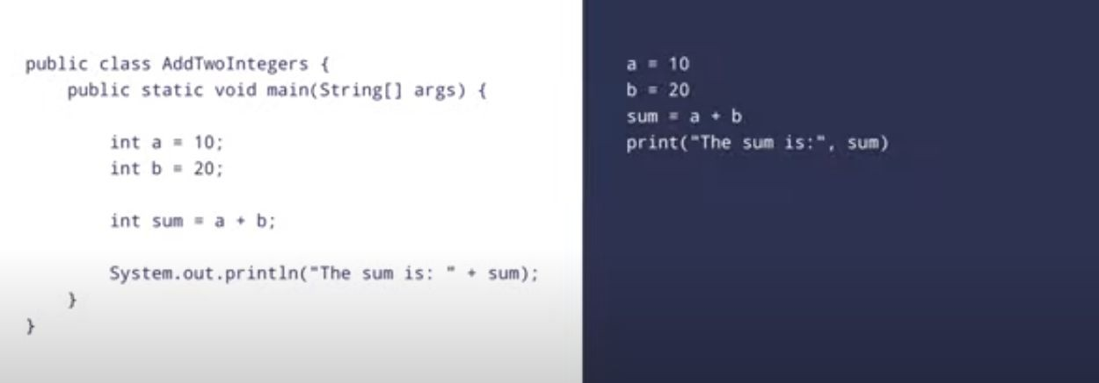
EASY
JAVA VS PYTHON
© baiju012

Slide 5
© baiju012
Google Facebook Quora Amazon Stripe Instagram Spotify Netflix Uber Reddit
Dropbox Pinterest NASA
Instacart Lyft
COMPANIES USING PYTHON
Industrial Light and Magic Intel
IBM
Pixar
JP Morgan Chase

Slide 6
© baiju012
Features of Python
Interpreted
Interactive
Object Oriented
Platform Independent & portable
Dynamic Typing
Easier debugging
Automatic Memory Management
Free and Open source

Slide 7
© baiju012
Components of Python
Functions
Collections of Statements , May return a value, reusable
Classes
Abstract data type, Blue print of an object
Modules
Group of Related Classes and Functions
Packages
Group of related Modules

Slide 8
© baiju012
History
Conception of Idea 1980
December 1989 –Implementation Guido Van Rossum
October 2000 – Python 2.0
December 2008 – Python 3.0 Released
Python 2.7 –EOL 2020

Slide 9
© baiju012
References
https://docs.python.org/3/tutorial/
https://www.tutorialspoint.com/python/index.htm
https://www.freecodecamp.org/news/learning-python-from-zero-to-hero-120ea540b567/
https://www.guru99.com/python-tutorials.html
https://www.programiz.com/python-programming/first-program
https://data-flair.training/blogs/python-tutorials-home/
https://data-flair.training/courses/python-course/lessons/1-1-introduction-to-python/
https://en.wikipedia.org/wiki/Python_(programming_language)
https://en.wikipedia.org/wiki/Programming_paradigm#Support_for_multiple_paradigms
https://en.wikipedia.org/wiki/Object-oriented_programming
https://en.wikipedia.org/wiki/Structured_programming
http://openbookproject.net/thinkcs/python/english3e/
https://levelup.gitconnected.com/6-must-try-python-programs-5d92ff36e620 (Projects For Fun)
https://book.pythontips.com/en/latest/args_and_kwargs.html
https://hackernoon.com/20-string-coding-interview-questions-for-programmers-6b6735b6d31c (LAB)

Slide 10
Agenda for Today
© baiju012
Downloading Options
Installing
First Program in Python

Slide 11
© baiju012
Download Options Python
Download from Microsoft Store. –search python 3.9
Download from Python (https://www.python.org/downloads/)
Download Thonny
Download Anaconda
Many others
Online Platforms without downloading.
Installing Jupyter Notebook - https://jupyter.org/install

Slide 12
© baiju012
Download & Install Spyder
1
Go to Anaconda website
2
Click on Download Options
3
Choose Installer and Click Download
4
Complete Setup and Click Finish
5
Launch Spyder from Anaconda

Slide 13

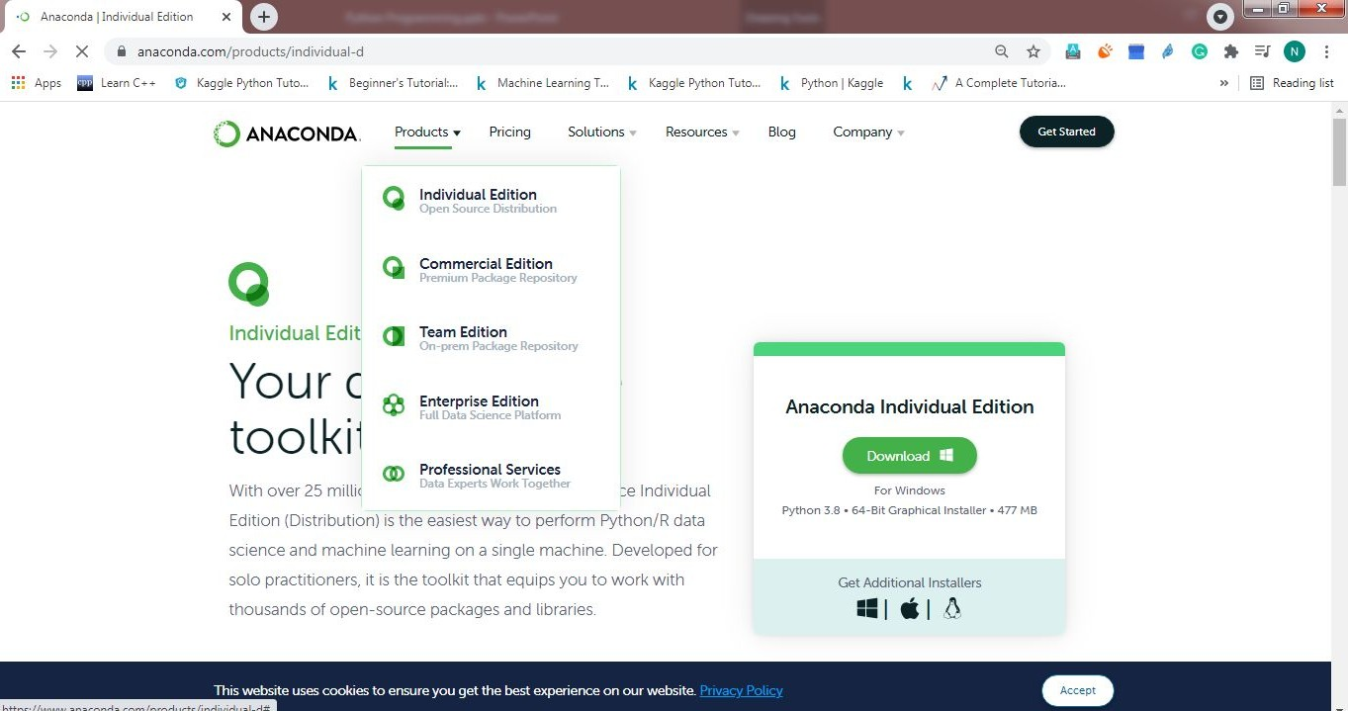
© baiju012
Follow steps
□ https://anaconda.com and select products, click Individual Edition & Download

Slide 14
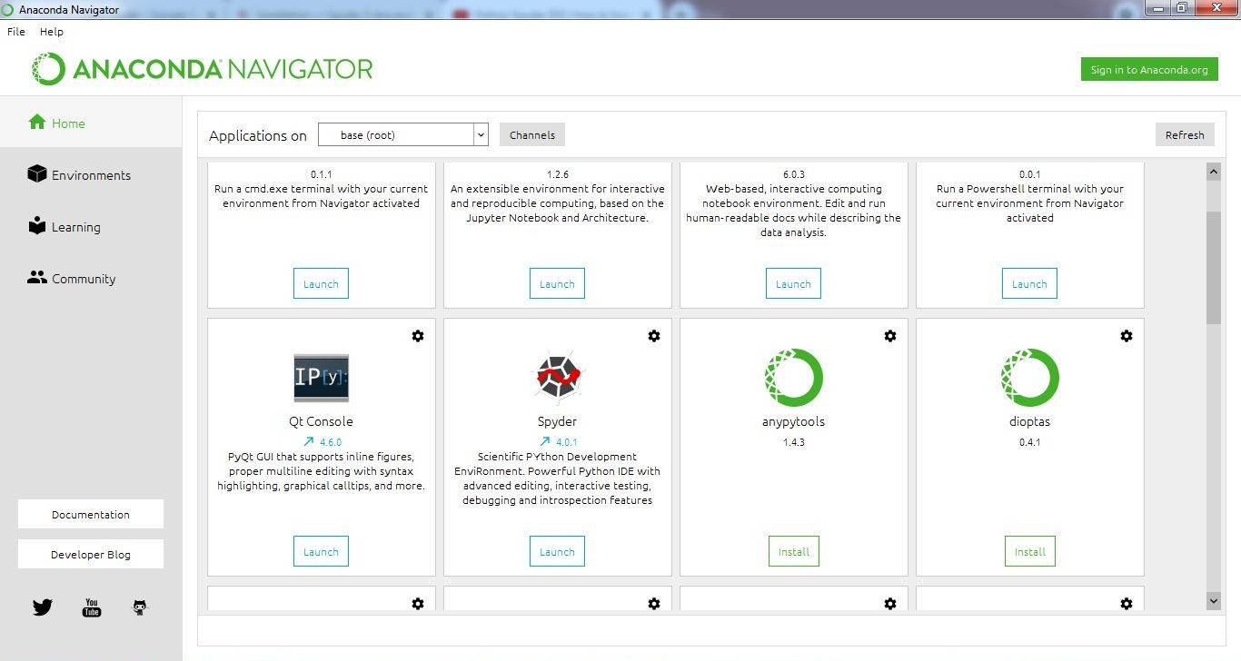
Launch Spyder from Anaconda Navigator
© baiju012

Slide 15
© baiju012
Create New File or Project
Go to File Menu and select new File or
Go to Projects Menu and select New Project- Give some Name to your Project and click Create.
Now You can see The Python interface..
□ Lets See….

Slide 16
© baiju012
Download & Install Python: Version 3.9.6
□ The Python download requires about 25 Mb of disk space; keep it on your machine, in case you need to re-install Python. When installed, Python requires about an additional 90 Mb of disk space.
□ Downloading
Click Python Download. (https://www.python.org/downloads/)
The following page will appear in your browser.

Slide 17
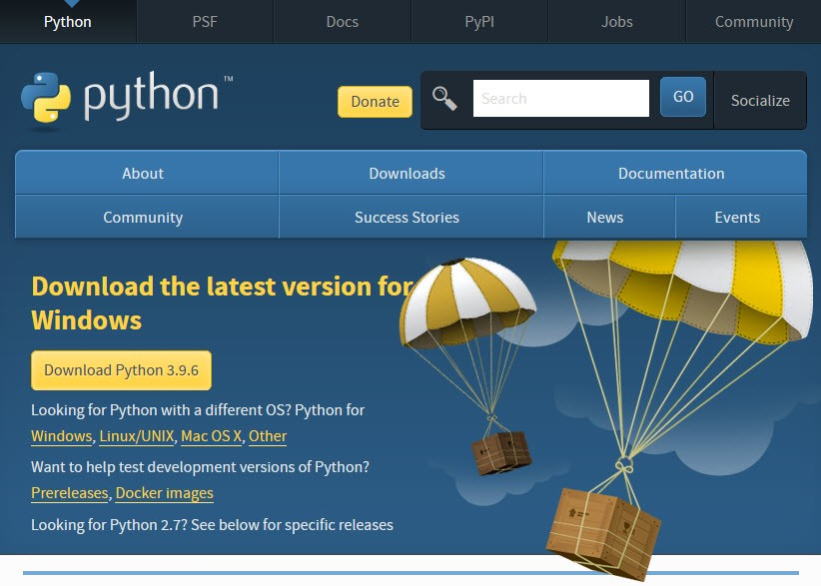
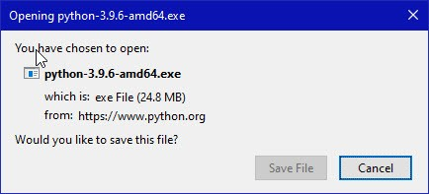
© baiju012
Click the Download Python
3.9.6 button. The following pop-up window titled Opening
python-3.96-amd64.exe will appear
Click the Save File button.
The file named python-3.9.6-amd64.exe should start downloading into your standard download folder. This file is about 25 Mb so it might take a while to download fully if you are on a slow internet connection.

Slide 18
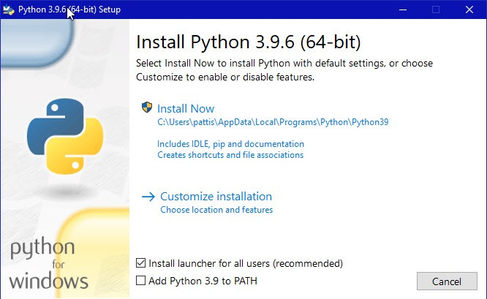
© baiju012
Move this file to a more permanent location, so that you can install Python (and reinstall it easily later, if necessary).
Feel free to explore this webpage further; if you want to just continue the installation, you can terminate the tab browsing this webpage.
Start the Installing instructions directly below.
Double-click the icon labeling the file python-3.9.6-amd64.exe.A Python 3.9.6 (64-bit) Setup pop-up window will appear.
Ensure that both the Install launcher for all users (recommended) and the Add Python 3.9 to PATH checkboxes at the bottom are checked: typically only first is checked by default.
If the Python Installer finds an earlier version of Python installed on your computer, the Install Now message may instead appear as Upgrade Now (and the checkboxes will not appear).
Highlight the Install Now (or Upgrade Now) message, and then click it.

Slide 19
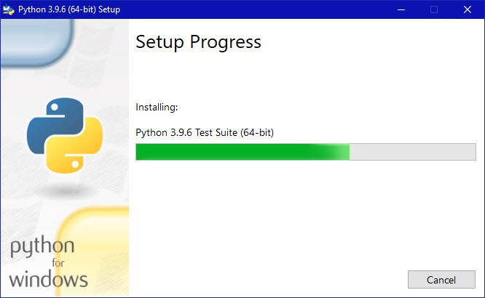
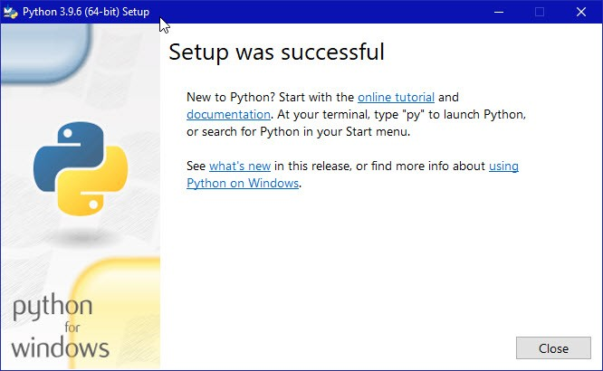
© baiju012
□ A new Python 3.9.6 (64-bit) Setup pop-up window will appear with a Setup Progress message and a progress bar.
During installation, it will show the various components it is installing and move the progress bar towards completion. Soon, a new Python 3.9.6 (64-bit) Setup pop-up window will appear with a Setup was successfuly message
Click the Close button. Python should now be installed.

Slide 20
© baiju012
Download & Install Sublime Text3
Go to website https://www.sublimetext.com/3
Select your OS and download.
Go to the download location and double click installation file.
Once installed, open sublime Text3, you are ready to write your code.
Write the code and save the file using .py extension.
Go to Tools menu select Build sytem, it should be on Automatic (confirm)
Now Again go to Tools and select build. Your code should run and a console window with ouput should appear.
For taking input install packagecontrol (press ctrl + shift +p) and type install, click and it should be installed and then press ctrl + shift +p and select packagecontrol:Install package and it will list the packeges which you can install, type sublimeREPL and install. Lets see…

Slide 21
© baiju012
New Build system for sublime
{
"cmd":["C:/Users/<user>/AppData/Local/Programs/Python/Python37-32/python.exe", "-u", "$file"], "file_regex": "^[ ]File \"(...?)\", line ([0-9]*)",
"selector": "source.python"
}

Slide 22
© baiju012
First Program -Hello World
print(“Hello World”)
Or
print(‘Hello World’)
Ex: Hello.py

Slide 23
© baiju012
Two ways of execution
Interactive Mode
Open command Prompt, type python or python3 ( depending on python installation) and then hit enter. Interface is open in interactive mode.
The standard prompt for the interactive mode is >>>, so as soon as you see these characters, you’ll know you are in. Now, you can write and run Python code as you wish, with the only drawback being that when you close the session, your code will be gone. when you work interactively, every expression and statement you type in is evaluated and executed immediately:
Script Mode
A plain text file containing Python code that is intended to be directly executed by the user is usually called script.
□ modules are meant to be imported, while scripts are made to be directly executed.
Script mode can be run from command prompt & IDE
Output can be saved using c;\> python Hello.py > out.txt

Slide 24
© baiju012
First program with modules
Create the file and put print(“Hello World”) in the file. Name the file HWM.py.
On python shell >>> import sys
>>> sys.path
>>>sys.path.append(r’ C:\Users\DIRECTORY_FOR_MODULE’)
>>>import HWM
>>>Hello World -----Output

Slide 25
Agenda for Today
© baiju012
Identifiers
Variables
String formatters
Python Statements

Slide 26
© baiju012
Identifiers
□ Names we give to identity variables, functions, variables and classes etc.
Rules:
Only begin with A-Z, a –z or underscore
0 or more letters, digits and underscore may follow.
It is case sensitive; name is not same as Name
Reserved words cannot be used as identifiers. ( approx. 35 )
Best Practice
Upper case Initials for class name, lowercase for all other. Name of private identifier with a leading underscore
Name of strongly private identifier with two leading underscore Special identifiers by python begin and end with two underscores.

Slide 27
© baiju012
Variables
Dynamic typing
No need to define datatype before assigning.
A =10 ( python knows it is integer)
B= 1.2 (float)
C = 1+3j (complex)
D=“Hello” or ‘Hello’ (string)
We can find the datatype of variable by using type method
type(A) – int
Type(B) - float
type(C) – complex
type(D) – str

Slide 28
© baiju012
Variables – Little More
Python a = 10
Puts value 10 in memory and a refers to the address of that memory
Java Int a = 10
Assigns 4 byte of memory for a and put value 10 in the assigned space
What happens when we change a = 12
Python a = 12
Puts value 12 in memory and a refers to the address of that memory. Reference to memory address of the value 10 is lost.
Java
a = 12
use same 4 byte of memory for a and put new value 12 in the assigned space, earlier where 10 was written

Slide 29
© baiju012
Checking the concept learned
□ A= 10
Id(A) – some unique number associated with storage suppose x1
□ A =11
Id(A) -some unique number associated with storage suppose x2
The two outputs from call to function id() will be different.
Lets check
Limit to storage
□ In java 4 bytes are allocated for the integer so the range of values it can store is fixed whereas in python there is no limit to the range of the values it can store, the only restriction is how much space your program has been allocated.

Slide 30
© baiju012
Assign Multiple values
Many Values to Multiple Variables
x, y, z = "Orange", "Banana", "Cherry" print(x)
print(y) print(z)
One Value to Multiple Variables
x = y = z = "Orange" print(x)
print(y) print(z)
Write a program to swap two values num1, num2 = 7,8

Slide 31
© baiju012
String formatters
X=10, printer=“HP”
print(“ I just printed %s pages from the printer %s”%(X,printer) -%
print(“ I just printed {} pages from the printer {1}”.format(X,printer)-format
print(“ I just printed {X} pages from the printer {printer}”,format(X=11,printer=‘Epson) – format with assignment
Print(f” I just printed {x} pages from the printer {printer}”) -f-strings

Slide 32
© baiju012
Examples
# Python3 program to demonstrate # the str.format() method
# using format option in a simple string
print("{}, A computer science Engineering in ."
.format(“Faculty of Engineering & Technolgy"))
# using format option for a # value stored in a variable
str = "This article is written in {}"
print(str.format("Python"))
# formatting a string using a numeric constant print("Hello, I am {} years old !".format(18))
To demonstrate the use of formatters # with positional key arguments.
# Positional arguments # are placed in order
print("{0} love {1}!!".format(“Fetians",“FET"))
# Reverse the index numbers with the # parameters of the placeholders
print("{1} love {0}!!".format(“Fetians", “FET"))
print("Every {} should know the use of {} {} programming and {}"
.format("programmer", "Open", "Source", "Operating Systems"))
# Use the index numbers of the
# values to change the order that # they appear in the string
print("Every {3} should know the use of {2} {1} programming and {0}"
.format("programmer", "Open", "Source", "Operating Systems"))
# Keyword arguments are called # by their keyword name
print("{gfg} is a {0} science portal for {1}"
.format("computer", "geeks", gfg="GeeksforGeeks"))
# Python program using multiple place
# holders to demonstrate str.format() method
# different datatypes can be used in formatting print("Hi ! My name is {} and I am {} years old"
.format("User", 19))
# The values passed as parameters
# are replaced in order of their entry
print("This is {} {} {} {}"
.format("one", "two", "three", "four"))

Slide 33
© baiju012
Python Statement
Instructions that a Python interpreter can execute are called statements.
a = 1 is an assignment statement.
if statement, for statement, while statement, etc. are other kinds of statements
Multi-line statement
In Python, the end of a statement is marked by a newline character. But we can make a statement extend over multiple lines with the line continuation character (\). For example:
a = 1 + 2 + 3 + \
4 + 5 + 6 + \
7 + 8 + 9
This is an explicit line continuation. In Python, line continuation is implied inside parentheses ( ), brackets [ ], and braces { }. For instance, we can implement the above multi-line statement as:
a = (1 + 2 + 3 +
4 + 5 + 6 +
7 + 8 + 9)
We can also put multi line statements in a single statement using ; A=1;b=2;c=3;
For multi line string statements we can use triple quotes.

Slide 34
© baiju012
Exercise
□ Exercise 1.1: The interpreter
Open the Python interpreter. What happens when you input the following statements:
(a) 3 + 1
(b) 3 * 3
(c) 2 ** 3
(d) "Hello, world!" Exercise 1.2: Scripts
Now copy the above to a script, and save it as script1.py. What happens if you run the script? (try:
python script1.py)

Slide 35
© baiju012
Agenda for Today
□ Strings

Slide 36
© baiju012
Strings:-
S = “Namit” or S=‘Namit’ are same
S=‘’’ My Name is Namit ‘’’ --- multi line strings
Indexing starts from 0 (strings as Arrays)
□ S[0] ---’N’ , S[1] ---’a’…..
□ Supports negative indexing i.e S[-1] ---t, S[-2]---- I
Strings are immutable (Not changeable)
a = “ Namit” ---a[0] = ‘S’ ---ERROR
For shorter strings with same value, they are stored at one place and reference is shared with different variables. That’s why strings are made immutable, so changes occur and both variables can have consistent view of the string.

Slide 37
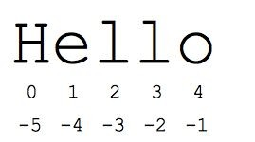
© baiju012
String Slicing
The "slice" syntax is a handy way to refer to sub-parts of sequences -- typically strings and lists. The slice s[start:end] is the elements beginning at start and extending up to but not including end. Suppose we have s = "Hello“
s[1:4] is 'ell' -- chars starting at index 1 and extending up to but not including index 4
s[1:] is 'ello' -- omitting either index defaults to the start or end of the string
s[:] is 'Hello' -- omitting both always gives us a copy of the whole thing (this is the pythonic way to copy a sequence like a string or list)
s
s[1:100] is 'ello' -- an index that is too big is truncated down to the string length

Slide 38
© baiju012
Negative slicing
The standard zero-based index numbers give easy access to chars near the start of the string. As an alternative, Python uses negative numbers to give easy access to the chars at the end of the string: s[-1] is the last char 'o', s[-2] is 'l' the next-to-last char, and so on. Negative index numbers count back from the end of the string:
s[-1] is 'o' -- last char (1st from the end)
s[-4] is 'e' -- 4th from the end
s[:-3] is 'He' -- going up to but not including the last 3 chars.
s[-3:] is 'llo' -- starting with the 3rd char from the end and extending to the end of the string.
WHAT WILL BE s[:3] + s[3:]?

Slide 39
© baiju012
Some Useful String Functions
a = “Hello Python”
len(a) – Gives the length of the String
a.lower() – Converts all Uppercase to Lower
a.upper() – Converts all lowercase to upper
a.find(‘Python’) -searches for the given other string (not a regular expression) within s, and returns the first index where it begins or -1 if not found.
a.strip() -- returns a string with whitespace removed from the start and end.
s.startswith('other'), s.endswith('other') -- tests if the string starts or ends with the given other string
s.split('delim') -- returns a list of substrings separated by the given delimiter. The delimiter is not a regular expression, it's just text. 'aaa,bbb,ccc'.split(',') -> ['aaa', 'bbb', 'ccc']. As a convenient special case s.split() (with no arguments) splits on all whitespace chars.

Slide 40
© baiju012
More functions
a.count(‘Python’) -Python string method count() returns the number of occurrences of substring sub in the range [start, end]. Optional arguments start and end are interpreted as in slice notation.
a.index(str, beg=0, end=len(string)) - Same as find(), but raises an exception if str not found.

Slide 41
© baiju012
String Concatenation
S = “red”
S = S + “blue” ----redblue ( new string) strings are immutable
S+= ‘ blue’ ----- redblueblue
A = “ blue”
A = A * 2 ---- blueblue ( i.e A+A)
A =A* 3 ---- blueblueblueblueblueblue (A+A+A)
What will be A = A * 1 ?
b = “yellow”
b = b + 3 --- error 3 is integer
Do b = b + str(3) --- yellow3

Slide 42
Agenda for Today
© baiju012
Indentation
Comments & Docstrings

Slide 43
© baiju012
Indentation
Python does not support use of curly braces to delimit the code blocks
Use Spaces, tabs or combination.
def square(a):
□ return a**2
Use can use global keyword to mark any variable to the global space
def myfunc():
global x
x = "fantastic"
myfunc() print("Python is " + x)
x = "awesome"
def myfunc(): global x
x = "fantastic"
myfunc() print("Python is " + x)

Slide 44
© baiju012
Comments & Docstrings
Comments are non-executable statements in Python and are present for human understanding, not for the compiler. Commenting your code helps explain your thought process and helps you and others to understand the intention of your code.
A comment in Python starts with the hash/Octothrope character, #, and extends to the end of the physical line.
Python docstrings are the string literals that appear right after the definition of a function, method, class, or module. Always start/end with triple quotes and is just bellow the declaration of function,class etc.
□ def square(a):
□ ‘’’computes square of input variable a’’’
return a*a
>>> square(3)
# try square. doc
□ Ex:Square.py

Slide 45
© baiju012
Arithmetic Operators
□ + Addition
- Subtraction
* Multiplication
/ Division
// Integer Division
** Exponentiation
% Modulus
□ A=10; B =4;
□ A/B =2.5 and A//B =2 and A**B 10000 and A%B = 2
“23” + “43” –string uses + operator for concatenation

Slide 46
© baiju012
Boolean Datatype
A boolean expression (or logical expression) evaluates to one of the two states - True or False. Several functions and operations in Python return boolean objects.
>>> a = True
>>> type(a) -<class ‘bool’>
Here True and False are Reserved keywords. ie They are not written as "True" or "False", as then they will be taken as strings and not boolean values.
C = "True" D = "False" Here, C and D are of type String.

Slide 47
© baiju012
Boolean Examples:
When you compare two values, the expression is evaluated and Python returns the Boolean answer:
□ print(10 > 9) print(10 == 9) print(10 < 9)
When you run a condition in an if statement, Python returns True or False
The bool() function allows you to evaluate any value, and give you True or False in return
print(bool("Hello")) print(bool(15))
In fact, there are not many values that evaluate to False, except empty values, such
as (), [], {}, "", the number 0, and the value None. And of course the value False evaluates to False.

Slide 48
© baiju012
Relational Operators
The operators which compare the values of their operands are called comparison/ relational operators. Python has 6 most common relational
□ == If the values of two operands are equal, then the condition is true, otherwise, it is false. Common Mistake:- Do not confuse it with the Assignment Operator(=). (X == Y) is True
!= If the values of the two operands are not equal, then the condition is true. (X != Y) is true.
> If the value of the left operand is greater than the value of the right operand, then the condition is true. (X > Y) is false
< If the value of the left operand is less than the value of the right operand, then the condition is true. (X < Y) is true.
>= If the value of the left operand is greater than or equal to the value of the right operand, then the condition is true. (X >= Y) is false.
<= If the value of the left operand is less than or equal to the value of the right operand, then the condition is true. (X <= Y) is true

Slide 49
© baiju012
Logical Operators
□ The operators which act on one or two boolean values and return another boolean value are called logical operators. There are 3 key logical operators.
and Logical AND: If both the operands are true then the condition is true. (X and Y) is false
or Logical OR: If any of the two operands are then the condition is true. (X or Y) is true
not Logical NOT: Used to reverse the logical state of its operand. Not(X) is false

Slide 50
© baiju012
an example code to understand the relational operators in Pythoann:other example code to understand the
□ x = 9
□ y = 13
print('x > y is',x > y) # Here 9 is not greater than 13
print('x < y is',x < y) # Here 9 is less than 13
print('x == y is',x == y) # Here 9 is not equal to 13
print('x != y is',x != y) # Here 9 is not equal to 13
print('x >= y is',x >= y) # Here 9 is not greater than or equal to 13x or y is True
print('x <= y is',x <= y) # Here 9 is less than 13
And we get the output as:
x > y is False
x < y is True
x == y is False
x != y is True
x >= y is False
x <= y is True
logical operators in Python: x = True
y = False
print('x and y is',x and y) print('x or y is',x or y) print('not x is',not x)
And we get the output as: x and y is False
not x is False
Do It yourself?
What if X is 3 and y is 4 What if x is ‘hi’ and y is ‘hey’ What if x is 1 and y is ‘hi’
Refer : short circuiting in python

Slide 51
Agenda for Today
© baiju012
Order of Operations & Associativity
Taking Input from user
Programming Exercise

Slide 52
© baiju012
Order of Operations & Associativity
□ The combination of values, variables, operators, and function calls is termed as an expression
□ Please Excuse My Dear Aunt Sally
P – Parenthesis
E – Exponentiation
M – Multiplication
D – Division
A – Addition
S – Subtraction
Associativity of Operators
Operators with the same precedence (except for **) are evaluated from left-to-right. In algebra we say they
are left-associative.
division, multiplication, remainder, etc. and the expressions will be evaluated from left to right
Non-Associative Operators
The comparison operator and the assignment operators do not support associativity.
10<20<30 is 10<20 and 20<30

Slide 53
Practice
© baiju012
5 – 2= | 9.0
10-5/5= | 1.0
2 * (3-1)= | 4.0
(1+1)**(5-2)= | 8.0
2**1+1= | 3.0
3*1**3= | 3.0
2 ** 3 ** 2= | 512
45 % 10 / 2 = | 2.5

Slide 54
© baiju012
Taking Input
Taking Input (Fah to Cel converter)
F = input()– This will input a string
F = int(input(“Enter temp. in Fahrenheit:”)
□ C = (F-32)* 5/9
Print(C)
Change the code above so it prints only upto 2 decimal places.

Slide 55
© baiju012
Convert given Seconds to Hrs, min and seconds
str_seconds = input("Please enter the number of seconds you wish to convert")
total_secs = int(str_seconds)
hours = total_secs // 3600
secs_still_remaining = total_secs % 3600
minutes = secs_still_remaining // 60
secs_finally_remaining = secs_still_remaining % 60
print("Hrs=", hours, "mins=", minutes, "secs=", secs_finally_remaining)

Slide 56
© baiju012
Programming Question
Write a program that takes, from the user value for Principal amount, rate of interest and time and calculates the simple interest.
Write a program that takes, from the user the length of the base and the height of the triangle. Make the function output the resulting area of the triangle as an integer.
Write a program that takes input from the user a number and calculates the square of the number.
□ Write a program to input marks of three tests of a student (all integers). Then calculate and print the average of all test marks.

Slide 57
© baiju012
Challenge 1
□ Challenge: Many people keep time using a 24 hour clock (11 is 11am and 23 is 11pm, 0 is midnight). If it is currently 13 and you set your alarm to go off in 50 hours, it will be 15 (3pm). Write a Python program to solve the general version of the above problem. Ask the user for the time now (in hours), and then ask for the number of hours to wait for the alarm. Your program should output what the time will be on the clock when the alarm goes off.

Slide 58
© baiju012
Challenge 2
□ It is possible to name the days 0 thru 6 where day 0 is Sunday and day 6 is Saturday. If you go on a wonderful holiday leaving on day number 3 (a Wednesday) and you return home after 10 nights you would return home on a Saturday (day 6). Write a general version of the program which asks for the starting day number, and the length of your stay, and it will tell you the number of day of the week you will return on.

Slide 59
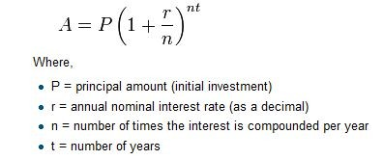
Challenge 3
© baiju012
□ Challenge: The formula for computing the final amount if one is earning compound interest is given on Wikipedia as
Write a Python program that assigns the principal amount of 10000 to variable P, assign to n the value 12, and assign to r the interest rate of 8% (0.08). Then have the program prompt the user for the number of years, t, that the money will be compounded for.
Calculate and print the final amount after t years.

Slide 60
© baiju012
Challenges 4 ,5 ,6
Challenge Write a program that will compute the area of a circle. Prompt the user to enter the radius and save it to variable called radius. Print a nice message back to the user with the answer.
Challenge: Write a program that will compute the area of a rectangle. Prompt the user to enter the width and height of the rectangle and store the values in variables called width and height. Print a nice message with the answer.
Challenge: Write a program that will compute MPG for a car. Prompt the user to enter the number of miles driven and store it in a variable called miles and the number of gallons used stored in a variable gallons. Print a nice message with the answer

Slide 61
Agenda for Today
© baiju012
□ Conditionals & Loops
□ Examples

Slide 62
© baiju012
Conditionals & Loops
There are certain points in our code when we need to make some decisions and then based on the outcome of those decisions we execute the next block of code. Such conditional statements in programming languages control the flow of program execution.
Most commonly used conditional statements in Python are:
Simple If statements
If-Else statements
If-Elif statements
Nested Conditionals

Slide 63
© baiju012
Simple If statements
These are the most simple decision-making/conditional statements. It is used to decide whether a certain statement or block of statements will be executed or not. The most important part of any conditional statement is a condition or a boolean. And the second important thing is the code block to be executed. In the case of simple If statements, if the conditional/boolean is true then the given code block is executed, else the code block is simply skipped and the flow of operation comes out of this If condition.
The general syntax of such statements in Python is:
if <Boolean/Condition>:
<Code Block to be executed in case the Boolean is True>
<Code Block to be executed in case the Boolean is False>
An example of a simple if statement can be as follows:
Val = False
if Val == True:
print("Value is True") # Statement 1
print("Value is False") # Statement 2
In the above code, the variable Val has a boolean value False, and hence the condition is not satisfied. Since the condition is not satisfied, it skips the If statement, and instead, the next statement is executed. Thus the output of the above code is:
Value is False

Slide 64
© baiju012
Else-if statements
The simple if statement, tells us that if a condition is true it will execute a block of statements, and if the condition is false it won’t. But what if we want some other block of code to be executed if the condition is false. Here comes the else statement. We can use the else statement with if statement to execute a block of code when the condition is
false. The general Syntax for the If-Else statement is:
if (Condition/Boolean):
<Code block to be executed in case the condition is True>
else:
<Code block to be executed in case the condition is False>
*** Keep in mind the indentation levels for various code blocks.

Slide 65
Distinguishing between Odd and Even numbers
© baiju012
□ Problem Statement: Given a number, print whether it is odd or even.
Approach: In order fora number to be even, it must be divisible by 2. Which means that the remainder upon dividing the number by 2 must be 0. Thus, in order to distinguish between odd and even numbers, we can use this condition. The numbers which leave a remainder 0 on division with 2 will be categorized as even, else the number is odd. This can be written in Python as follows:-
Since 23 is an odd number, it doesn’t satisfy the if condition, and hence it goes to else and executes the command
num = 23
If num%2 == 0:
print("Even Number")
else:
print("Odd Number")
The output of this code will be:- Odd Number

Slide 66
© baiju012
If-Elif-Else statements
□ Imagine a situation in which if a condition is satisfied, we want a particular block of code to be executed, and if some other condition is fulfilled we want some other block of code to run. However, if none of the conditions is fulfilled, we want some third block of code to be executed. In this case, we use an if-elif-else ladder . The if statements are executed from the top down .
if <Condition 1>:
<Execute this code block>
elif <Condition 2>:
<Execute this code block>
.
.
elif <Condition X>:
<Execute this code block>
else:
<Execute this code block>

Slide 67
© baiju012
Finding the largest among three numbers
Problem Statement: Given three numbers A, B and C, find the largest among the three and print it. Approach: Let A, B, and C, be 3 numbers. We can construct an if-elif-else ladder. We have to consider the following conditions:
-If A is greater than or equal to both B and C, then A is the largest Number.
-If B is greater than or equal to both A and C, then B is the largest number.
-However, if none of these conditions is true it means that C is the largest number.
A,B,C = 10,20,30
if A>=B and A>= C: print(A)
elif B>=C and B>=A: print(B)
else:
Print(C)

Slide 68
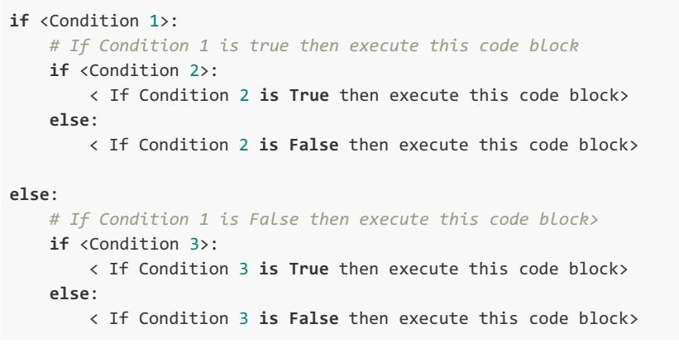
© baiju012
Nested Conditionals
□ A nested if is an if statement that is present in the code block of another if statement. In other words, it means- an if statement inside another if statement. A nested conditional will be executed only when the
parent conditional is true.

Slide 69
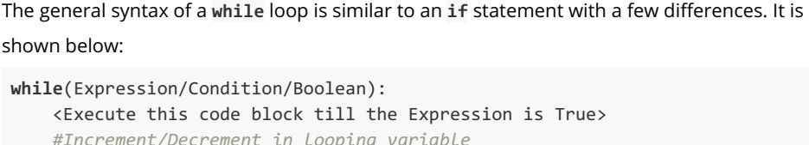
© baiju012
While Loop
□ the while loop continues to execute the code repeatedly, as long as the expression is True. In other words, a while loop iterates over a block of code. In Python, the body of a while loop is determined by the indentation. It starts with indentation and ends at the first unindented line.
The most important part of a while loop is the looping variable. This looping variable controls the flow of iterations

Slide 70
© baiju012
Example
□ Problem Statement: Given an Integer n, Find the Sum of first n Natural numbers.
□
n = 4
sum = 0
i = 1 #Initialising the looping variable to 1
while (i<=n): #The loop will continue till the value of i<number
sum = sum + i
i = i+1 #Value of i is updated at the end of every iteration
print(sum)
□
We get the output as: 10

Slide 71
© baiju012
Break, continue & pass:
Exit the loop when i is 3:
Continue to the next iteration if i is 3:
Pass
i = 1
while i < 6: print(i)
if i == 3: break
i += 1
i = 0
while i < 6: i += 1
if i == 3: continue print(i)
n=2
if n==2:
pass #Pass statement:
Nothing will happen
else:
print ("Executed”)
The pass statement is a null statement.
It is generally used as a placeholder for future code, you cannot leave the space blank as it will give a compilation error.
Sometimes, pass is used when the user does not want any code to execute.

Slide 72
© baiju012
The else Statement
With the else statement we can run a block of code once when the condition no longer is true:
Example
Print a message once the condition is false:
□ i = 1
while i < 6: print(i)
i += 1
else:
print("i is no longer less than 6")

Slide 73
© baiju012
Check Prime: Using While Loop and Nested If Statements
Problem Statement: Given any Integer, check whether it is Prime or Not.
Approach to be followed: A prime number is always positive so we are checking that at the beginning of the program. Next, we are dividing the input number by all the numbers in the range of 2 to (number - 1) to see whether there are any positive divisors other than 1 and the number itself (Condition for Primality). If any divisor is found then we display, “Is Prime”, else we display, “Is Not Prime”.
Note:- We can use the break statement in the loop to come out of the loop as soon as any positive divisor is found as there is no further check required.

Slide 74
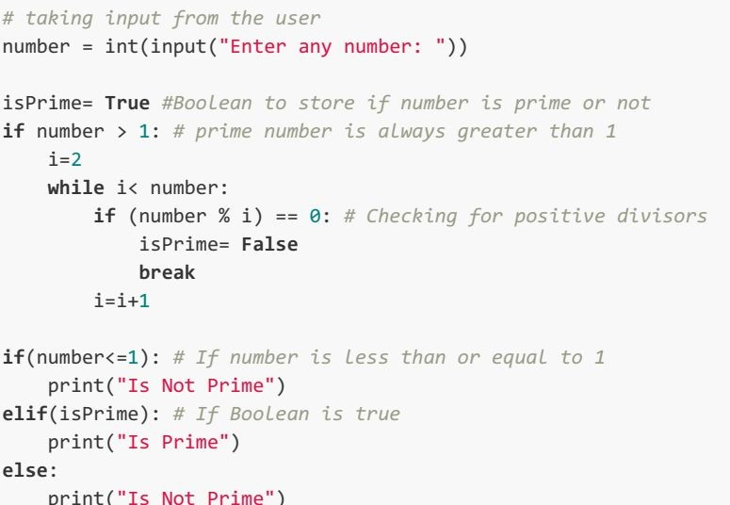
Solution:
© baiju012

Slide 75
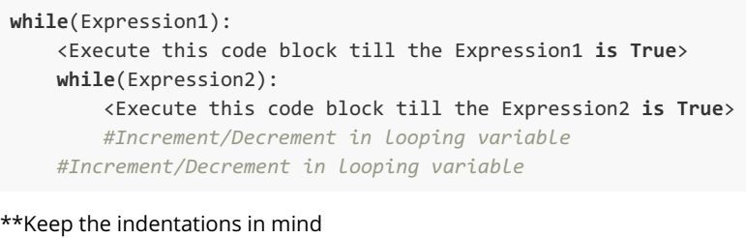
© baiju012
Nested Loops
□ Python programming language allows the usage of one loop inside another loop. The loops can be nested the same way, the conditional statements are. The general syntax of such an arrangement is:

Slide 76
Print All Primes- Using Nested Loops
© baiju012
□ Problem Statement: Given an Integer, Print all the Prime Numbers between 0 and that Integer.
□
Approach to be followed: Run a loop from 2 - n, in order to check which all numbers in this range are prime. Let the value of the looping variable for this loop in some iteration be i. Run another loop inside this loop which will check if i is prime or not. This loop will run from 2 to i (Similar to the Check Prime Problem). This way we have a loop nested inside another

Slide 77
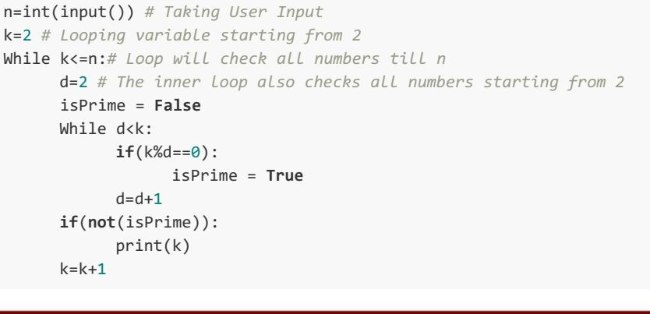
Solution:
© baiju012

Slide 78
Agenda for Today
© baiju012
Ternary Operator
More on Loops

Slide 79
© baiju012
Ternary operator in Python
Ternary operators are more commonly known as conditional expressions in Python. These operators evaluate something based on a condition being true or not. They became a part of Python in version 2.4.
Syntax
□ value_if_true if condition else value_if_false
Example:
is_nice = True
state = "nice" if is_nice else "not nice"

Slide 80
© baiju012
Example 2:
[on_true] if [expression] else [on_false]
With If else statement With ternary operator
>>> x, y = 5, 6
>>> if x>y:
print("x")
else:
print("y")
>>>y
>>> x, y = 5, 6
>>> print("x" if x> y else "y") y
Find minimum of two numbers a, b = 10, 20
# Copy value of a in min if a < b else copy b min = a if a < b else b

Slide 81
© baiju012
More on Loops
□ A sequence in Python is a succession of values bound together by a single name.
□ range() Function
The range() function in Python generates a List which is a special sequence type. The syntax of the range() function is given below:
range(<Lower Limit>, <Upper Limit>) # Both limits are integers
The function, range(L,U), will produce a list having values L, L+1, L+2....(U-1).
Note: The lower limit is included in the list but the upper limit is not.
For Example:
>>> list(range(0,5))
[0,1,2,3,4] #Output of the range() function
Note: The default step value is +1, i.e. the difference in the consecutive values of the sequence generated will be +1. If you want to create a list with a step value other than 1, you can use the following syntax:
range(<Lower Limit>, <Upper Limit>, <Step Value>)
The function, range(L, U, S), will produce a list [L, L+S, L+2S...<= (U-1)].
For Example:
>>> list(range(0,5,2))
[0,2,4] #Output of the range() function

Slide 82
© baiju012
range() Examples
□ L1 = list(range(0,5)) ------ 0, 1, 2 ,3 ,4
□ L1 = list(range(5)) ------ 0, 1, 2 ,3 ,4
□ L1 = list(range(0,5,1))
□ L1 = list(range(0,5,2))
□ L1 = list(range(5,-1,-1))
□ L1 = list(range(-5,-1,1))
□ L1 = list(reversed(range(-5,-1,1))) ------ -2, -3, -4, -5
------ 0, 1, 2 ,3 ,4
------ 0, 2 ,4
------ 5, 4, 3, 2, 1,0
------ -5, -4, -3, -2

Slide 83
© baiju012
IN Operator
□ in Operator
The in operator tests if a given value is contained in a sequence or not and returns True
or False accordingly. For eg.,
□ 3 in [1,2,3,4]
will return True as value 3 is contained in the list.
"A" in "BCD"
will return False as "A" is not contained in the String "BCD".

Slide 84
© baiju012
For Loop
□ The for loop of Python is designed to process the items of any sequence, such as a list or a string, one by one. The syntax of a for loop is:
□ for <variable> in <sequence>: Statements_to_be_executed
For example, consider the following loop:
for a in [1, 4, 7]:
print(a)
The given for loop will be processed as follows:
Firstly, the looping variable a will be assigned the first value from the list i.e. 1, and the statements inside the for loop will be executed with this value of a. Hence 1 will be printed.
Next, a will be assigned 4 and 4 will be printed,
Finally, a will be assigned 7, and 7 will be printed.
All the values in the list are executed, hence the loop ends.

Slide 85
© baiju012
Functions
What is a Function?
A Function is a sequence of statements/instructions that performs a particular task. A function is like a black box that can take certain input(s) as its parameters and can output a value after performing a few operations on the parameters
Uses:
Code Reusability
Clean Code ( OH! Its so clean and tidy)
Modularization
□ Easy Debugging

Slide 86
© baiju012
Types Of Functions
We can divide functions into the following two types:
User-defined functions: Functions that are defined by the users. Eg. The
add() function we created.
Inbuilt Functions: Functions that are inbuilt in python. Eg. The print()
function.
Import math
Math module has many functions related to mathematics

Slide 87

© baiju012
Glimpse Math module
import math
Lets find Decibels for SNR (signal to noise ratio) ( unit dB)
Decibels = 10 * log (ratio)
For example, your measured noise value (N) is 2 microvolts, and your signal (S) is 300 millivolts.
□ Db = 10 * log (.3 / .000002) --- calculate
□
□
□
Use math.radians(degree) – compare the result
- calculate

Slide 88
© baiju012
Defining a function
□ A function in Python is defined as per the following syntax:
def <function-name>(<parameters>): """ Function's docstring """
<Expressions/Statements/Instructions>
□ def add(a,b):
return a+b
□ A return statement is used to end the execution of the function call and it “returns” the result (value of the expression following the return keyword) to the caller. The statements after the return statements are not executed. If the return statement is without any expression, then the special value None is returned.

Slide 89
© baiju012
Calling a Function
Arguments: The values being passed to the function from the function call statement are called arguments. Eg. 5 and 7 are arguments to the add() function.
Parameters: The values received by the function as inputs are called parameters. Eg. a and b are the parameters of the add() function.
□ A function call takes the following form:
<function-name> (<value-to-be-passed-as-argument>) add(5,7)
In this function call, a = 5 and b = 7.

Slide 90
© baiju012
Main Function
A Python module is a file that has a .py extension. All we need to do is create a file that contains legitimate Python code and give the file a name with .py extension.
A module can be imported to other modules or run directly via command line.
The name is a special built-in variable which evaluates to the name of the current module. However, if a module is being run directly (from command line),
then name instead is set to the string “ main ”.
def main():
print ("Hello World!")
if name == " main ": main()

Slide 91
© baiju012
More on main
Let’s put together this little code example for understanding. Suppose we create two modules,
foo and bar with the following code:
# foo.py
import bar
print("foo. name set to ", name ) And the bar module:
# bar.py
print("bar. name set to ", name )
On invoking the bar module from command line, its name attribute will be set to “ main ”: python bar.py
>>> output
bar. name set to main
However, on invoking the foo module in a similar fashion, the bar’s name attribute will be set equivalent to it’s module name i.e bar:
python foo.py
>>>ouput
bar. name set to bar
foo. name set to main
Therefore, we can test whether our module is being run directly or being imported

Slide 92
© baiju012
Passing By Reference
All parameters (arguments) in the Python language are passed by reference. It means if you change what a parameter refers to within a function, the change also reflects back in the calling function.

Slide 93
© baiju012
Function Arguments
You can call a function by using the following types of formal arguments −
Required arguments
Keyword arguments
Default arguments
Variable-length arguments

Slide 94
© baiju012
Required Arguments
□ Required arguments are the arguments passed to a function in correct positional order. Here, the number of arguments in the function call should match exactly with the function definition.
# Function definition is here def printme( str ):
"This prints a passed string into this function" print str
return;
# Now you can call printme function printme() ---Error

Slide 95
© baiju012
Keyword arguments
Keyword arguments are related to the function calls. When you use keyword arguments in a function call, the caller identifies the arguments by the parameter name.
This allows you to skip arguments or place them out of order because the Python interpreter is able to use the keywords provided to match the values with parameters.
# Function definition is here def printinfo( name, age ):
"This prints a passed info into this function" print ("Name: ", name )
print ("Age ", age) return;
# Now you can call printinfo function printinfo( age=50, name="miki" )

Slide 96
© baiju012
Default Arguments to a Function
□ A default argument is an argument that assumes a default value if a value is not provided in the function call for that argument.
# Function definition is here def printinfo( name, age = 35 ):
"This prints a passed info into this function" print ("Name: ", name)
print ("Age ", age) return;
# Now you can call printinfo function printinfo( age=50, name="miki" ) printinfo( name="miki" )

Slide 97
© baiju012
Variable length Arguments
You may need to process a function for more arguments than you specified while defining the function. These arguments are called variable-length arguments and are not named in the function definition.
The special syntax *args in function definitions in python is used to pass a variable number of arguments to a function. It is used to pass a non-key worded, variable-length argument list. (including zero or more)
Example: Write a program to add any numbers passed to the function.
def add_num(*args): sum = 0
for num in args:
sum += num return sum
IMP: Before variable args you can have a formal argument but not after a variable args. After variable argument you can have keyword arguments. *args are stored as tuple.

Slide 98
© baiju012
Key worded Varags
Python keyword variable length argument is an argument that accept variable number of keyword arguments (arguments in the form of key, value pair). To indicate that the function can take keyword variable length argument you write an argument using double asterisk ‘**’, for example **kwargs.
Values passed as keyword variable length argument are stored in a dictionary that is referenced by the keyword kwarg name.
Python program to illustrate
# *kargs for variable number of keyword arguments
def myFun(**kwargs):
for key, value in kwargs.items():
print ("%s == %s" %(key, value))
# Driver code
myFun(first =‘CSE', mid =‘FET', last='GKV')

Slide 99
© baiju012
Example
Python program to illustrate
# one extra argument, *kwargs for variable number of keyword arguments
def myFun(*args,**kwargs):
for key, value in kwargs.items():
print ("%s == %s" %(key, value))
# Driver code
myFun(‘Namit’, first =‘CSE', mid =‘FET', last=‘GKV')

Slide 100
© baiju012
Example
def myFun(arg1, arg2, arg3):
print("arg1:", arg1)
print("arg2:", arg2)
print("arg3:", arg3)
# Now we can use *args or **kwargs to # pass arguments to this function :
args = (“Namit", “Khanduja") myFun(*args)
kwargs = {"arg1" : “CS&E", "arg2" : “FET", "arg3" : "GKV"} myFun(**kwargs)
def myFun(*args,**kwargs): print("args: ", args) print("kwargs: ", kwargs)

Slide 101
© baiju012
Anonymous Functions
Functions with no name and explicit return statement.
They are part of Functional programming.
They are defined using lambda keyword.
Lambda forms can take any number of arguments but return just one value in the form of an expression.
An anonymous function cannot be a direct call to print because lambda requires an expression
Lambda functions have their own local namespace and cannot access variables other than those in their parameter list and those in the global namespace.

Slide 102
© baiju012
Contd.
Syntax:
lambda arguments: expression
Example 1:
double = lambda x: x * 2 print(double(10))
In the above code, lambda x: x * 2 is the lambda function. Also, their x is the argument and x * 2 is the expression that gets evaluated and returned to the user.
Example 2
# Function definition is here
sum = lambda arg1, arg2: arg1 + arg2 # Now you can call sum as a function
print "Value of total : ", sum( 10, 20 ) print "Value of total : ", sum( 20, 20 )

Slide 103
© baiju012
Code comparison
def squares_def(x): return x*x print('Using def: ', squares_def(5))
# Types print(type(squares)) print(type(squares_def))
# calculate squares using lambda squares = lambda x: x*x print('Using lambda: ', squares(5))
Internally both the lambda and Normal functions work same
# Bytecode instructions of lambda function import dis
dis.dis(squares) dis.dis(squares_def)

Slide 104
Lambda Contd.
© baiju012
You can implement a lambda function without using a variable name. You can also directly pass the argument values into the lambda function right after defining it using parenthesis. This cannot be done using def functions.
(lambda x,y : x*y)(5,7) #> 7
A lambda function can take another function as an argument.
Let’s look at an example of a nested lambda functions, a lambda function inside another lambda function.
# Define a lambda function that can take another lambda function (func1). high_order = lambda x, lmbfunc: x*lmbfunc(x)
# The inner lambda function is defined when calling the high_order. high_order(10, lambda x : x*x) #> 1000

Slide 105
© baiju012
Lambda with Filter function
filter() function is used to filter a given iterable (list like object) using another function that defines the filtering logic. A lambda function is typically used to define the filtering logic and is passed as the first argument of filter(). An iterable like a list object is passed as the second argument to the filter function.
# Using lambda inside filter function
□ mylist = [2,3,4,5,6,7,8,9,10]
list_new = list(filter(lambda x : (x%2==0), mylist))
print(list_new)
□ #> [2, 4, 6, 8, 10]

Slide 106
© baiju012
Lambda with Map function
map() function applies a given function to all the items in a list and returns the result. Similar to filter(), simply pass the lambda function and the list (or any iterable, like tuple) as arguments.
# using lambda inside map function mylist = [2,3,4,5,6,7,8,9,10]
list_new = list(map(lambda x : x%2, mylist)) print(list_new)
#> [0, 1, 0, 1, 0, 1, 0, 1, 0]

Slide 107
© baiju012
Lambda with reduce function
reduce() function performs a repetitive operation over the pairs of the elements in the list. Pass the lambda function and the list as arguments to the reduce() function.
For using the reduce() function, you need to import reduce from functools library.
# Using lambda inside reduce from functools import reduce list1 = [1,2,3,4,5,6,7,8,9]
sum = reduce((lambda x,y: x+y), list1) print(sum)
#> 45

Slide 108
© baiju012
Scope of a variable
□ All variables in a program may not be accessible at all locations in that program. Part(s) of the program within which the variable name is legal and accessible, is called the scope of the variable
Global Scope
A variable/name declared in the top-level segment ( main ) of a program is said to have a global scope and is usable inside the whole program (Can be accessed from anywhere in the program).
In Python, a variable declared outside a function is known as a global variable. This means that a global variable can be accessed from inside or outside of the function.
Local Scope
Variables that are defined inside a function body have a local scope. This means that local variables can be accessed only inside the function in which they are declared

Slide 109
© baiju012
The Lifetime of a Variable
The lifetime of a variable is the time for which the variable exists in the memory.
The lifetime of a Global variable is the entire program run (i.e. they live in the memory as long as the program is being executed).
The lifetime of a Local variable is their function’s run (i.e. as long as their function is being executed).
CREATING GLOBAL VARIABLE
x = "Global Variable"
def foo():
print("Value of x: ", x)
foo()

Slide 110
© baiju012
Global Variables
□ What if you want to change the value of a Global Variable from inside a function?
Consider the code snippet:
x = "Global Variable"
def foo():
x = x -1 print(x)
foo()
This happens because, when the command x=x-1, is interpreted, Python treats this x as a local variable and we have not defined any local variable x inside the function foo()

Slide 111
© baiju012
Local Variables
We declare a local variable inside a function.
Consider the given function definition:
def foo():
y = "Local Variable" print(y)
foo()
We get the output as:
Local Variable
Accessing A Local Variable Outside The Scope def foo():
y = "local"
foo() print(y)

Slide 112
© baiju012
Global Variable And Local Variable With The Same Name
□ x = 5
def foo():
x = 10
print("Local:", x)
foo() print("Global:", x)
□ Local: 10 Global: 5

Slide 113
© baiju012
Python Default Parameters
□ Function parameters can have default values in Python. We can provide a default value to a parameter by using the assignment operator (=). Here is an example. def wish(name, wish="Happy Birthday"):
"""This function wishes the person with the provided message. If the message is not provided, it defaults to "Happy Birthday" """
print("Hello", name + ', ' + wish)
greet("Rohan")
greet("Hardik", "Happy New Year")
Output
Hello Rohan, Happy Birthday Hello Hardik, Happy New Year

Slide 114

© baiju012
Recursion
It is legal for one function to call another or call itself
□
□
□
□
□
□
□
A function that calls itself is recursive; the process of executing it is called recursion.

Slide 115

© baiju012
As another example
we can write a function that prints a string
times.
If n <= 0 the return statement exits the function. The flow of execution immediately returns to the caller, and the remaining lines of the function don’t run.
The rest of the function is similar to countdown: it displays s and then calls itself to
display s n−1n−1 additional times. So the number of lines of output is 1+(n−1)1+(n−1), which adds up to n.
What is Infinite Recursion?

Slide 116
© baiju012
Example factorial of a Number
□ def factorial(n): if n == 0:
return 1
else:
recurse = factorial(n-1) result = n * recurse return result

Slide 117
Example of Fibonnaci Number f0=0, f1=1, fn= f(n-2)+f(n-1)
© baiju012
def fib(n):
if (n == 0):
return 0
elif (n == 1):
return 1
else:
return fib(n - 1) + fib(n - 2)

Slide 118
© baiju012
Lists
store a sequence of values belonging to any type . (Sequence Data Structure).
The Lists are contained within square brackets ( [ ] )
Each item in a list has an assigned index value.
Items in a list are separated by a comma.
Lists are mutable. (can be changed)
[ ] #Empty list
[1, 2, 3] #List of integers
[1, 2, 5.6, 9.8] #List of numbers (Floating point and Integers)
['a', 'b', 'c'] #List of characters
['a', 1, 4.3, "Zero"] #List of mixed data types
["One", "Two", "Three"] #List of strings

Slide 119
© baiju012
Creating a list
list1 = [] #Empty list
list2 = [1, 2, 3] #List of integers
list3 = [1, "One", 3.4] #List with mixed data types
A list can also have another list as an element. Such a list is called a Nested List. list4 = ["One", [8, 4, 6], ['Three']]

Slide 120
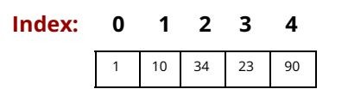
© baiju012
Operations On Lists
Accessing Elements of List
□ List indices start at 0 and go on till 1 less than the length of the list.
□ Note: Trying to access indexes out of the range (0 ,lengthOfList-1), will raise an IndexError. Also, the index must be an integer. We can't use float or other types, this will result in TypeError.
□ Let us take an example to understand how to access elements in a list: l1 = ['Mother', 'Father', 'Daughter', 10, 23]
>> print(l1[0]) #Output: 'Mother'
>> print(l1[2]) #Output: 'Daughter'
>> print(l1[4]) #Output: 23

Slide 121
© baiju012
Contd.
Negative Indexing
Python allows negative indexing for its sequences.
Positive Indexing: 0 1 2 3 4
→
1 | 10 | 34 | 23 | 90
Negative Indexing: -5 -4 -3 -2 -1
l1 = ['Mother', 'Father', 'Daughter', 10, 23]
>> print(l1[-1]) #Output: 23
>> print(l1[-2]) #Output: 10
>> print(l1[-6]) #Output: IndexOutOfRange error

Slide 122
© baiju012
Changing elements of list
□ Once a list is created, we can even change the elements of the list. This is done by using the assignment operator (=) to change the value at a particular list index.
l1 = ['Mother', 'Father', 'Daughter', 10, 23]
l1[-1] = "Daughter" #Changing the last element to "Daughter"
L1[3] = 12 #Changing the element at index 3 to 12
print(l1)
Output:
['Mother', 'Father', 'Daughter', 12, "Daughter"]

Slide 123
© baiju012
Concatenation of Lists
Joining or concatenating two list in Python is very easy. The concatenation operator ( +), can be used to join two lists. Consider the example given below:
□
l1= [1,2,3] #First List
l2= [3,4,5] #Second List
l3= l1+l2 #Concatenating both to get a new list
print(l3)
□ Output:
[1,2,3,3,4,5]
Note: The + operator when used with lists requires that both the operands are of list types. You cannot add a number or any other value to a list.

Slide 124
© baiju012
Repeating/Replicating Lists
□ Like strings, you can use * operator to replicate a list specified number of times. Consider the example given below:
□
>>> l1 = [1,2, 10, 23]
>>> print(li*3) [1,2,10,23,1,2,10,23,1,2,10,23] #Output
Notice that the above output has the same list l1 repeated 3 times within a single list.

Slide 125
© baiju012
List Slicing
□ List slicing refers to accessing a specific portion or a subset of a list while the original list remains unaffected.
□ Syntax
slice= <List Name>[StartIndex : StopIndex : Steps]
The StartIndex represents the index from where the list slicing is supposed to begin. Its default value is 0, i.e. the list begins from index 0 if no StartIndex is specified.
The StopIndex represents the last index up to which the list slicing will go on. Its default value is (length(list)-1) or the index of the last element in the
list.
steps represent the number of steps. It is an optional parameter. steps, if defined, specifies the number of elements to jump over while counting from StartIndex to StopIndex. By default, it is 1.
The list slices created, include elements falling between the indexes StartIndex and StopIndex, including StartIndex and not including StopIndex.

Slide 126
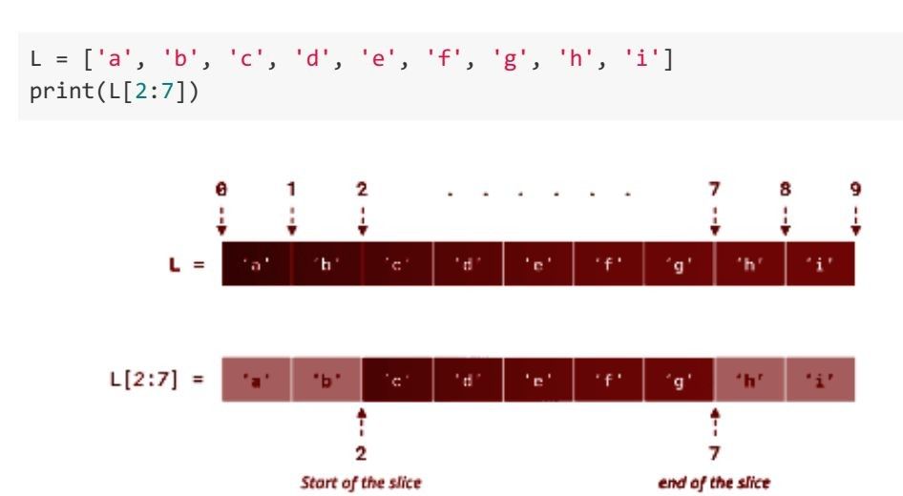
Slicing Example
© baiju012

Slide 127
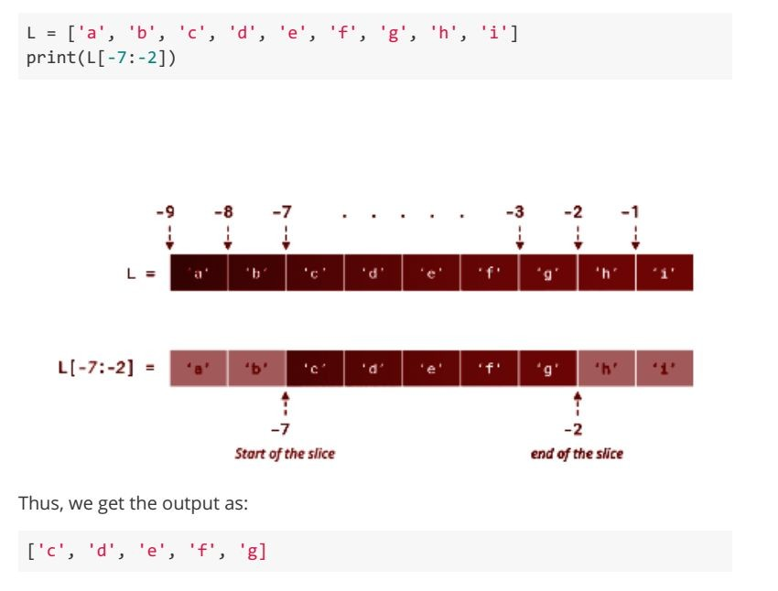
Negative Slicing
© baiju012

Slide 128

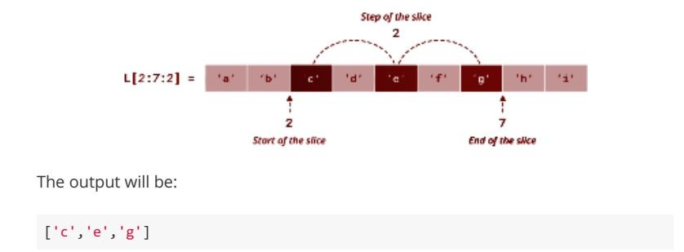
Slicing with Step size
© baiju012
□ Default size is 1.
Lets see the Example with +ve Steping

Slide 129
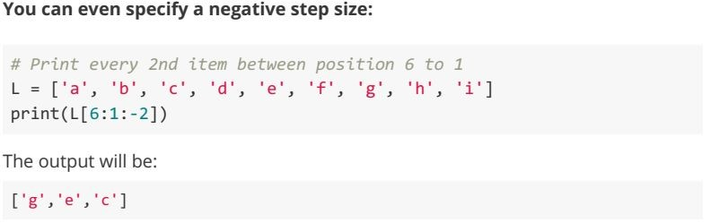
Contd. (-ve Stepping with slicing)
© baiju012

Slide 130
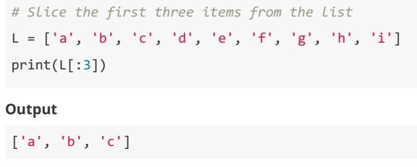
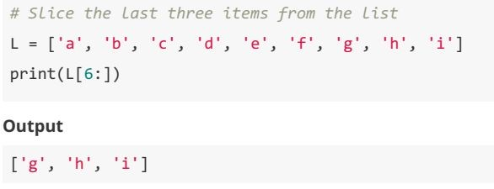
Slice at Beginning & Ending
© baiju012

Slide 131
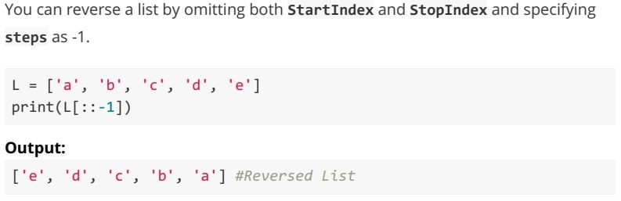
Reversing a List
© baiju012

Slide 132
© baiju012
Few Functions on List
append(): Used for appending/adding elements at the end of a list.
Syntax: <ListName>.append(element)
extend(): Adds the contents of List2 to the end of List1. Syntax: <ListName1>.extend(<ListName2)
insert(): Inserts an element at a specified position/index in a list.
Syntax: <ListName>(position, element)
sum() : Returns the sum of all the elements of a List. (Used only for lists containing numerical values)
Syntax: sum(<ListName>)
count(): Returns the total number of times a given element occurs in a List.
Syntax: <ListName>.count(element)
len(): Returns the total length of a List.
Syntax: len(<ListName>)
index(): Returns the index of first occurrence of an element in a list. If element is not present, it returns -1.
Syntax: <ListName>.index(element)

Slide 133
© baiju012
Few Functions on List
min() : Returns the minimum element in a List.
Syntax: min(<ListName>)
max(): Returns the maximum element in a List.
Syntax: max(<ListName>)
pop(): It deletes and returns the element at the specified index. If we don't mention the index, it by default pops the last element in the list.
Syntax: <ListName>.pop([index])
del() : Element to be deleted is mentioned using list name and index.
Syntax: del <ListName>[index]
remove(): Element to be deleted is mentioned using list name and element. Removes first occurance.
Syntax: <ListName>.remove(element)
list.sort(*, key=None, reverse=False) Sort the items of the list in place (the arguments can be used for sort customization, see sorted() for their explanation). Itemgetter() , key
list.reverse() Reverse the elements of the list in place.
list.copy() Return a shallow copy of the list. Equivalent to a[:].

Slide 134
© baiju012
Looping On Lists
There are multiple ways to iterate over a list in Python.
Using for loop
li = [1, 3, 5, 7, 9]
# Using for loop
for i in li:
print(i) #Print the element in the list
Output: 1
3
5
7
9
Using for loop and range()
list = [1, 3, 5, 7, 9]
length = len(list) #Getting the length of the list
for i in range(length): #Iterations from 0 to (length-1)
print(i)
Output:
1 2 3 4 5
range(1,10,2) will print 1 3 5 7 9
You can even use while() loops. Try using the while() loops on your own

Slide 135
© baiju012
Taking List as User Input
□ Line Separated or Space Separated
The way to take line separated input of a list is described below:
Create an empty list.
Let the number of elements you wish to put in the list be N.
Run a loop for N iterations and during these N iterations do the following:
Take an element as user input using the input() function.
Append this element to the list we created.
At the end of N iterations, you would have appended N desired elements to your list.
In this, different elements will have to be entered by the user in different lines.

Slide 136
© baiju012
Space Separated Input Of List
□ Using split() method
This function helps in taking multiple inputs from the user in a single line . It breaks the given input by the specified separator. If a separator is not provided then any white space is treated as a separator.
Note: The split() method is generally used to split a string.
Syntax :
input().split(<separator>) #<separator> is optional
In[]: a= input().split() In[]: print(a)
User[]: 1 2 3 4 5 #User inputs the data (space separated input)
Out[]: ['1','2','3','4','5']

Slide 137
© baiju012
Using List Comprehension
□ List comprehension is an elegant way to define and create a list in Python. We can create lists just like mathematical statements in one line only.
A common syntax to take input using list comprehension is given below. inputList= [int(x) for x in input().split()]
Question : Based on a list of fruits, you want a new list, containing only the fruits with the letter "a" in the name.
fruits = ["apple", "banana", "cherry", "kiwi", "mango"] newlist = []
for x in fruits: if "a" in x:
newlist.append(x)
print(newlist)

Slide 138
© baiju012
Now use List Comprehension
fruits = ["apple", "banana", "cherry", "kiwi", "mango"] newlist = [x for x in fruits if "a" in x]
print(newlist)
Example : Only accept items that are not "apple": newlist = [x for x in fruits if x != "apple"]
Example : Return "orange" instead of "banana":
newlist = [x if x != "banana" else "orange" for x in fruits]

Slide 139
© baiju012
More Examples List comprehension
Without List comprehension Squares =[]
For I in range(10): squares.append(I **2)
Print (squares)
With List Comprehension
Squares = [i**2 for I in range(10)]
lst= [-10,-20,10,20,50]
print(lst)
# Multiplying by 2 new_lst = [i*2 for i in lst] print(new_lst)
#finding positive elements new_pos_lst = [i for i in lst if i>= 0] print(new_pos_lst)

Slide 140
© baiju012
Exercise
Given a list (Matrix) with = [ [1 , 2 , 3 , 4] ,
[5 , 6 , 7 , 8 ] ,
[9 , 10 , 11 , 12]]
Write a program to transpose the given matrix without list comprehension and with List comprehension.
OUTPUT
transposed = [ [1 , 5 , 9] ,
[2 , 6 , 10] ,
[3 , 7 , 11] ,
[4 , 8 , 12]]

Slide 141
© baiju012
Solution:
Without List Comprehension transposed = []
for i in range(4):
lst[]
for row in matrix: lst.append(row[i])
transposed.append(lst) Print( transposed)
With List Comprehension
transposed = [ [ row[i] for row in matrix] for i in range(4)]

Slide 142
© baiju012
List Sorting
□ Example Sort the list alphabetically:
□ thislist = ["orange", "mango", "kiwi", "pineapple", "banana"] thislist.sort()
print(thislist)
Example Sort the list numerically:
□ thislist = [100, 50, 65, 82, 23] thislist.sort()
print(thislist)
Example Sort the list descending(String)
□ thislist = ["orange", "mango", "kiwi", "pineapple", "banana"] thislist.sort(reverse = True)
print(thislist)
□ Example: Sort the list descending: (numbers)
□ thislist = [100, 50, 65, 82, 23] thislist.sort(reverse = True) print(thislist)

Slide 143
© baiju012
Customize Sort Function
You can also customize your own function by using the keyword argument key = function.
The function will return a number that will be used to sort the list (the lowest number first):
Example
Sort the list based on how close the number is to 50:
def myfunc(n): return abs(n - 50)
thislist = [100, 50, 65, 82, 23] thislist.sort(key = myfunc) print(thislist)

Slide 144
© baiju012
Contd
□ Example Perform a case-insensitive sort of the list:
□ thislist = ["banana", "Orange", "Kiwi", "cherry"] thislist.sort(key = str.lower)
print(thislist)
□ Example Reverse the order of the list items:
thislist = ["banana", "Orange", "Kiwi", "cherry"] thislist.reverse()
print(thislist)
Question : Sum of all unique numbers in a list.

Slide 145
© baiju012
Questions
□ WAP to Sum of all unique numbers in a list.
WAP to remove duplicates from a list.
Given two lists , concatenate index wise
□ list1 = ["M", "na", "i", "Ke"]
□ list2 = ["y", "me", "s", "lly"]
□ Output [My, name, is Kelly]
□ Concatenate two lists in the following order
list1 = ["Hello ", "take "]
list2 = ["Dear", "Sir"]
Expected output:
['Hello Dear', 'Hello Sir', 'take Dear', 'take Sir']
Remove empty strings from the list of strings
list1 = ["Mike", "", "Emma", "Kelly", "", "Brad"]
output“[Mike", "Emma", "Kelly", "Brad"]

Slide 146
© baiju012
Tuples
Can be viewed as writing multiple elements in one way.
Similar to List.
Most important difference is tuple is immutable (cannot change items once created)`
Create a tuple T=() # empty tuple
T= ( 1,2,3) # tuple of integers
T = (1,’raju’,28,’abc’)# mixed tuple
T = (1,(2,3,4),[1,’raju’]) # nested tuple
What is t = (‘Satish’) ? Tuple or String
What is t = ‘Satish’, ? Tuple or String

Slide 147
© baiju012
Accessing & Slicing Tuple
T= (‘Satish’,’murali’,’Naveen’,’siri’,’brahma’)
T[1] --- murali
T[-1] --- brahma
T=(‘ABC’, (‘Satish’,’Naveen’,’siri’))
T[1] = (‘Satish’,’Naveen’,’siri’)
□ T[1][2] = ‘siri’
□ T= (1,2,3,4,5,6)
□ T[0:4] or T[:4]– 1,2,3,4
□ T[:-2] -- 1,2,3,4
□ T[:] =1,2,3,4,5,6
Strings, tuples and list are ordered as they can be indexed

Slide 148
© baiju012
Concatenation & deletion
□ T= (1,2,3,4, [5,6,7])
What will be result of T[2] =‘x’? And T[4][1] =‘Satish’?
□ T = (1,2,3) + (4,5,6) #concatenation
If a = 1, 2 and b = 3,4 What will be d= a, b # Tuple of Tuples
T = (‘Satish’, * 4) – WHAT WILL HAPPEN IF YOU REMOVE EXTRA COMMA
□ IF T = 1,2,3
WHAT WILL BE NEW_T = T * 2 ?
del T --- deletes a tuple

Slide 149
© baiju012
Tuple functions
□ T = (1,2,3,1,3,3,4,1)
T.count(1) ---- 3 # No. of occurrence
T.index(3) ----2 # First occurrence
( 1 in T) -- True
7 not in T --- True
len(T) --- #length of tuple
sorted(T) ----sorts the tuple
max(T) --- maximum element in Tuple (not for mixed tuple)
min(T) --- minimum element in Tuple
sum(T) --- sum up all elements in tuple
□ L1 = [1,2,3]
tuple(L1) # generates tuple from list

Slide 150
© baiju012
Dictionary
It is Unordered collection of items. (Key: value pair placed within curly braces} (tuple, list and string are ordered)
Mydict ={} # empty dictionary
Mydict = {1 : ”one”, 2 : “two”} # dictionary with integer keys
□ Mydict = { “one” : “namit”, 1 : [“cse”,”fet”] , 2 : (2,”gkv), 3 : [ (AI,ML,DL), (PYTHON,R)} # mixed valued dictionary with mixed keys
Create dictionary using dict()
Mydict = dict()# pass list of comma separated pairs in round brackets
Mydict = dict([ (1,’abc’) , (2,’pqr’)]) #dict from list of tuples
B = Mydict.copy() # copying a dictionary

Slide 151
© baiju012
Mydict = dict.fromkeys([1,2,”one”]) # generates key value pair from the list of keys passed, the value by default will be NONE
Mydict = dict.fromkeys([1,2,”one”],10) # generates dictionary with keys passed as list and the value 10 assigned to all keys
□ Mydict = { 1 : 2, 3 : 4, ’list’: [1,23], ’dict’ : {1:2} } #Mixed dictionary

Slide 152
© baiju012
Accessing dictionary elements
□ Let a ={ 1: 2, 3: 4, “list”:[1,2,3], ‘dict’ : {1:2}}
a[1] # prints 2 , index using keys
a.get(1) # prints 2 , index using keys
a[4] # error key not present
a.get(4) # no response ( no error message)
a.get(4, 0) # prints 0 if key not present & will return value if key is present
a.keys() # allows access to all keys ONLY KEYS
a.values() # allows access to all values ONLY VALUES
a.items() # allows access to key value pairs KEY,VALUE PAIRS

Slide 153
© baiju012
Deletion
□ Let a ={ 1: 2, 3: 4, “list”:[1,2,3], ‘dict’ : {1:2}}
□ b={3:5, ‘the’:4, 2:1000}
a[5] = 12 # Add to dictionary
a.popitem() # Removes last item from the dict
a.pop(3) # Removes the item with key =3
del a[1] # Removes the item with key =3
a.clear() # Removes all elements from dict
a.update(b) comman values will be updated with value of b and rest will be added
□ a ={ 1: 2, 3: 5, “list”:[1,2,3], ‘dict’ : {1:2}, ‘the’:4, 2:1000 }

Slide 154
Note on Keys in Dictionary
© baiju012
Important to remember is that a key has to be unique in a dictionary, no duplicates are allowed.
However, in case of duplicate keys rather than giving an error, Python will take the last instance of the key to be valid and simply ignore the first key-value pair.
See it for yourself:
sweet_dict = {'a1': 'cake', 'a2':'cookie', 'a1': 'icecream'} print(sweet_dict['a1'])

Slide 155
Dictionary Comprehension
© baiju012
Syntax :dictionary = {key: value for vars in iterable}
Example 1:
square_dict = dict()
for num in range(1, 11): square_dict[num] = num*num
print(square_dict)
# dictionary comprehension example
square_dict = {num : num*num for num in range(1, 11)} print(square_dict)

Slide 156
Example 2
© baiju012
dict1 = {'a': 1, 'b': 2, 'c': 3, 'd': 4, 'e': 5}
# Double each value in the dictionary double_dict1 = {k:v*2 for (k,v) in dict1.items()} print(double_dict1)
OUTPUT {'e': 10, 'a': 2, 'c': 6, 'b': 4, 'd': 8}
#Changing Keys
dict1_keys = {k*2:v for (k,v) in dict1.items()} print(dict1_keys)
O/P {'dd': 4, 'ee': 5, 'aa': 1, 'bb': 2, 'cc': 3}

Slide 157
Example 3
© baiju012
Consider the following problem, where you want to create a new dictionary where the key is a number divisible by 2 in a range of 0-10 and it's value is the square of the number. A) for loop and B) dictionary comprehension:
numbers = range(10) new_dict_for = {}
# Add values to `new_dict` using for loop for n in numbers:
if n%2==0: new_dict_for[n] = n**2 print(new_dict_for)
{0: 0, 8: 64, 2: 4, 4: 16, 6: 36}
# Use dictionary comprehension
new_dict_comp = {n : n**2 for n in numbers if n%2 == 0} print(new_dict_comp)

Slide 158
Example 4
© baiju012
#item price in dollars
old_price = {'milk': 1.02, 'coffee': 2.5, 'bread': 2.5}
dollar_to_pound = 0.76
new_price = {item: value*dollar_to_pound for (item, value) in old_price.items()} print(new_price

Slide 159
Example 5 (with conditionals)
© baiju012
original_dict = {'jack': 38, 'michael': 48, 'guido': 57, 'john': 33} 1)even_dict = {k: v for (k, v) in original_dict.items() if v % 2 == 0} print(even_dict)
2)new_dict = {k: v for (k, v) in original_dict.items() if v % 2 != 0 if v < 40} print(new_dict)
3) new_dict_1 = {k: ('old' if v > 40 else 'young') for (k, v) in original_dict.items()}
print(new_dict_1)

Slide 160
Example 6
© baiju012
dict1 = {'a': 1, 'b': 2, 'c': 3, 'd': 4, 'e': 5, 'f':6}
dict1_tripleCond = {k:v for (k,v) in dict1.items() if v>2 if v%2 == 0 if v%3 == 0}
print(dict1_tripleCond)
{‘f’:6}
dict1 = {'a': 1, 'b': 2, 'c': 3, 'd': 4, 'e': 5, 'f':6}
# Identify odd and even entries
dict1_tripleCond = {k:('even' if v%2==0 else 'odd') for (k,v) in dict1.items()} print(dict1_tripleCond)
{'f': 'even', 'c': 'odd', 'b': 'even', 'd': 'even', 'e': 'odd', 'a': 'odd'}

Slide 161
Sorting
© baiju012
A dictionary is an unordered collection that itself cannot be sorted. Sorting a dictionary returns a list containing tuples of key-value pairs where the tuples are sorted by key. For example, sorting the dictionary {"b": 2, "c": 3, "a": 1} by key returns [("a", 1), ("b", 2), ("c", 3)].
#sorting
□ a = {1:"d", 2:"z", 5:"b", 4:'a'}
print(sorted(a))
print(sorted(a.keys()))
print(sorted(a.values()))
print(sorted(a.items(),reverse=True))
print(sorted(a, key = a.get)) # sort by values
[1, 2, 4, 5] # sort by keys
[1, 2, 4, 5] # sort by keys ['a', 'b', 'd', 'z'] #
[(5, 'b'), (4, 'a'), (2, 'z'), (1, 'd')]
[4, 5, 1, 2]

Slide 162
© baiju012
Sorting with Dictionary comprehension
□ a = {1:"d",2:"z",5:"b",4:'a'}
print(sorted(a.keys()))
o/p[1, 2, 4, 5] # sort by keys
1) Creating dic with loops 2 ) Create dic with dict comp
#creating dict with sorting by keys using sorted method with a and a.keys a = {1:"d",2:"z",5:"b",4:'a'}
d = {k : a.get(k,0) for k in sorted(a)} # try a.keys() instead of print(d)
{1: 'd', 2: 'z', 4: 'a', 5: 'b'}

Slide 163
© baiju012
Example 2
#sorting
□ a = {1:"d",2:"z",5:"b",4:'a'}
print(sorted(a.items(),reverse=True))
□ [(5, 'b'), (4, 'a'), (2, 'z'), (1, 'd')]
□ [5,4,2,1]
#creating dict with reverse sorting by items i.e key using sorted method
a = {1:"d",2:"z",5:"b",4:'a'}
d = { k : a.get(k,0) for k in sorted(a, reverse=True)} print(d)
{5: 'b', 4: 'a', 2: 'z', 1: 'd'}

Slide 164
© baiju012
Exercise : Create dict using sorting method and dict comprehension.
print(sorted(a))
print(sorted(a.keys()))
print(sorted(a.values()))
print(sorted(a.items(),reverse=True))
print(sorted(a, key = a.get)) # sort by values
For all above methods create dict using sorted method and dict comprehension? Without dict comprehension i.e with loops

Slide 165
© baiju012
Exercise
Combine the values of two dict having same key
Concat values with same keys in a list of dict
Merge two dict with diff keys
Merge two dict with same keys
Do it in Lab file

Slide 166
© baiju012
Sets
# 1. sets are unordered collection of items. (No indexing)
# 2. All elements in sets are unique. (No Duplicates)
# 3. sets are mutable. We can add and remove elements.
# 4. used to perform mathematical operations like union, intersection and symmetric difference.

Slide 167
© baiju012
Creating sets
# Creating a set
□
□
□
□
□
s = {1,2,3} # contain only keys print(type(s))
print(s)
s1 = set([3,4,5]) # creating set uisng list print(s1)
# indexing: unordered, they have no indexing
□ s[1] # error

Slide 168
© baiju012
Adding elements
# adding elements : sets are mutable
print(s)
s.add(4) # adds single element to the set
print(s)
s.update([5,6,7]) # multiple elements in the set
print(s)
□ s.update([8,9], {10,11,12})

Slide 169
© baiju012
Removing elements from set
s.remove(4) --- removes element. if element/ key is not present gives error
S.discard(4) --- removes element. if element/ key is not present does not give error.
s.pop() # removes one element randomly
s.clear() – removes all elements of the set
del s # deletes entire set

Slide 170
© baiju012
set operations
# set operations : union, intersection, symmetric difference s1 = {1,2,3,4,5}
s2 = {3,4,5,6,7}
# union - all elements in s1 and s2 ( no duplicates) print(s1 | s2) # using or operation print(s1.union(s2)) # using union method
{1, 2, 3, 4, 5, 6, 7}
# intersection -- only comman elements
print(s1 & s2) # using & operation print(s1.intersection(s2)) # using intersection method
{3, 4, 5}

Slide 171
© baiju012
contd
# set difference : set of elements that are only in s1 but not in s2
print( s1 - s2) # using minus operation
print( s1.difference(s2)) # using difference method
{1, 2}
# symmetric difference : Elements present in A and B but not in both of them ,i.e (A U B)
- (A inter B)
print(s1 ^ s2)
print( s1.symmetric_difference(s2))
{1, 2, 6, 7} x = {'a','b','c','d'} y = {'c','d'}
print(y.issubset(x)) # if y is in x return true

Slide 172
© baiju012
Frozensets
# immutable
# sets cannot be used as key in dict, but we can use frozen sets as key in dict. Sets are unhashable.
Supports union, intersection and other operations.
# create frozenset()
□ s3 = frozenset([1,2,3,4])

Slide 173
© baiju012
Linear Search (Optional Reading)
Linear search is the simplest searching algorithm that searches for an element in a list in sequential order.
Given: Array and the target_value to be searched
If target_value is found , print index of the location else -1.
Linear Search Algorithm:
Traverse the given list using a loop.
In every iteration, compare the targetValue with the value of the element in the list in the current iteration.
If the values match, print the current index of the list.
If the values do not match, move on to the next list element.
If no match is found, print -1.

Slide 174
© baiju012
Linear Search Code (python)
val_found = False for x in list1:
If x == target_value:
print(list1.index(x))
val_found = True
break;
if val_found == False: print(-1)
# Write a program to take user input of the comma separated list and the target_ value to be searched. Use linear search algorithm to find the index of the target_value if found, otherwise print -1. Use functions.

Slide 175
© baiju012
Binary Search
□ Given a sorted array/list. Find the mid of the array using (start + end)/2 (integer division), compare the element at mid with the target_value, if target is greater, then change start to mid, if target is smaller change end to mid, and again find mid. Keep doing until target is found or array/list is exhausted.

Slide 176
© baiju012
Learn and Make Python Projects
https://www.datacamp.com/community/tutorials/simplifying-sentiment-analysis-python
https://www.datacamp.com/community/tutorials/building-a-chatbot-using-chatterbot

